Slide 1
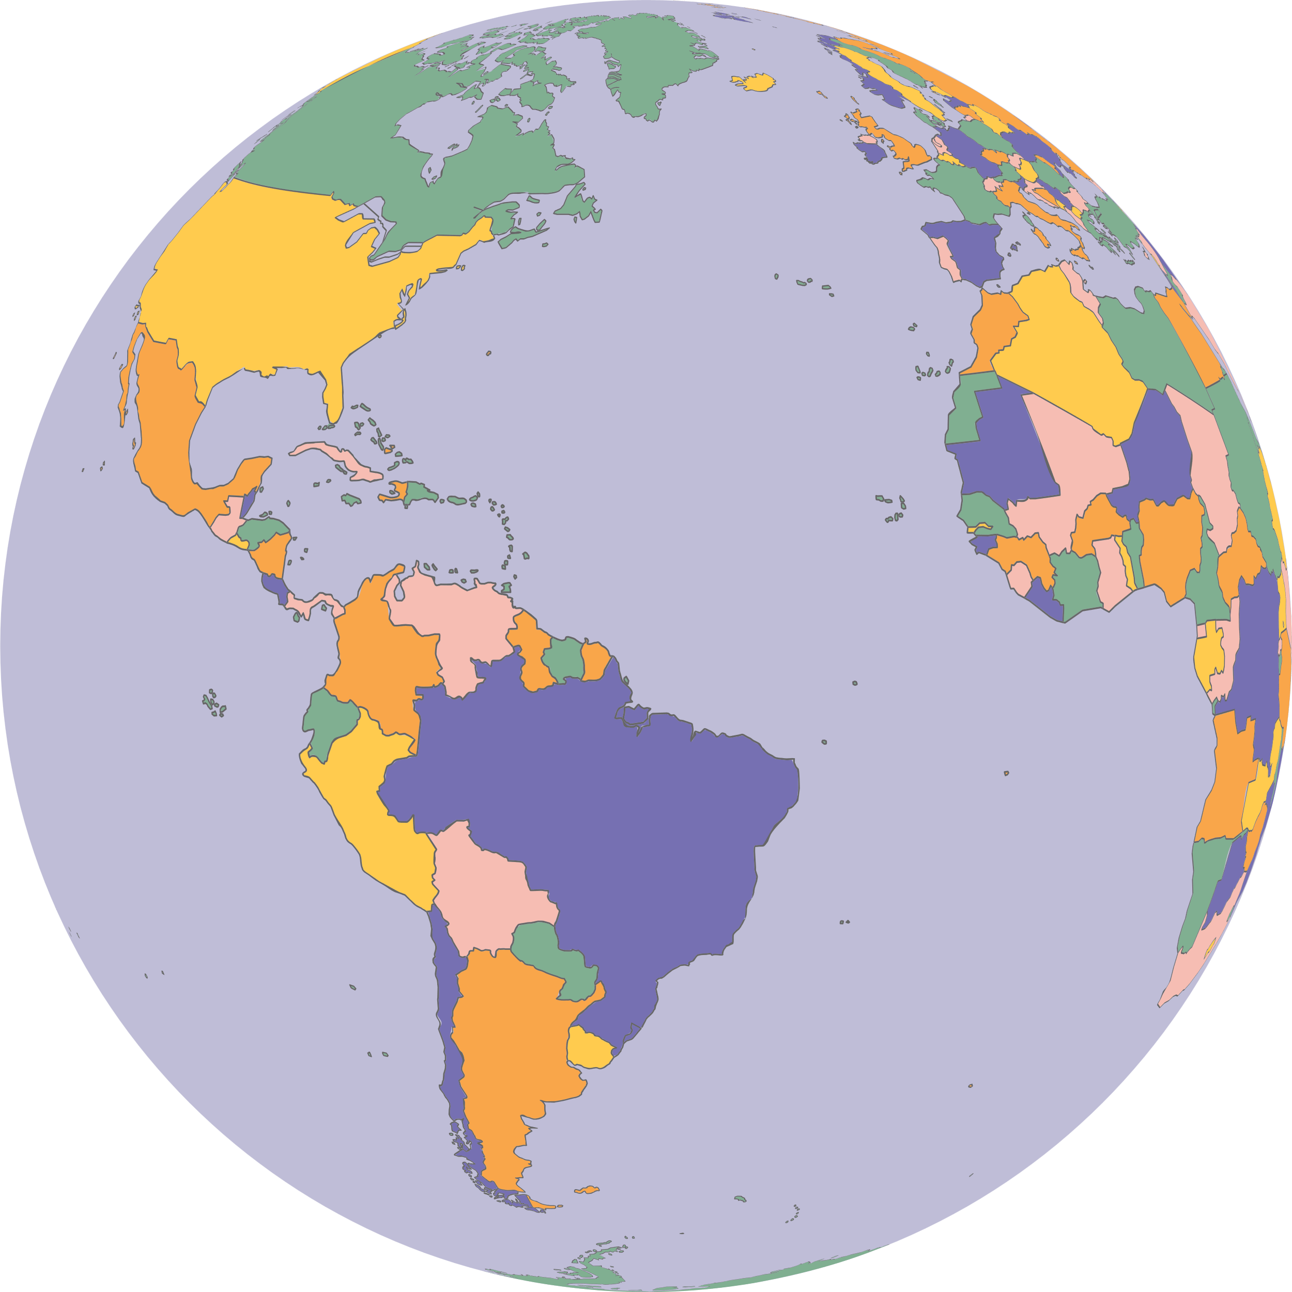
DSN 4006 DAV
Team-Members
Kunal 23106052
Harshit 23106057
DAV Project - Geo Lookup

Slide 2
Problem Statement
• Fragmented environmental data across disconnected platforms
• No real-time integration of AQI, weather, and location
• Static reports lack interactive visualization capabilities
• Manual data aggregation delays decision-making
• Growing need for hyperlocal environmental insights
• Students/researchers lack centralized monitoring tools

Slide 3


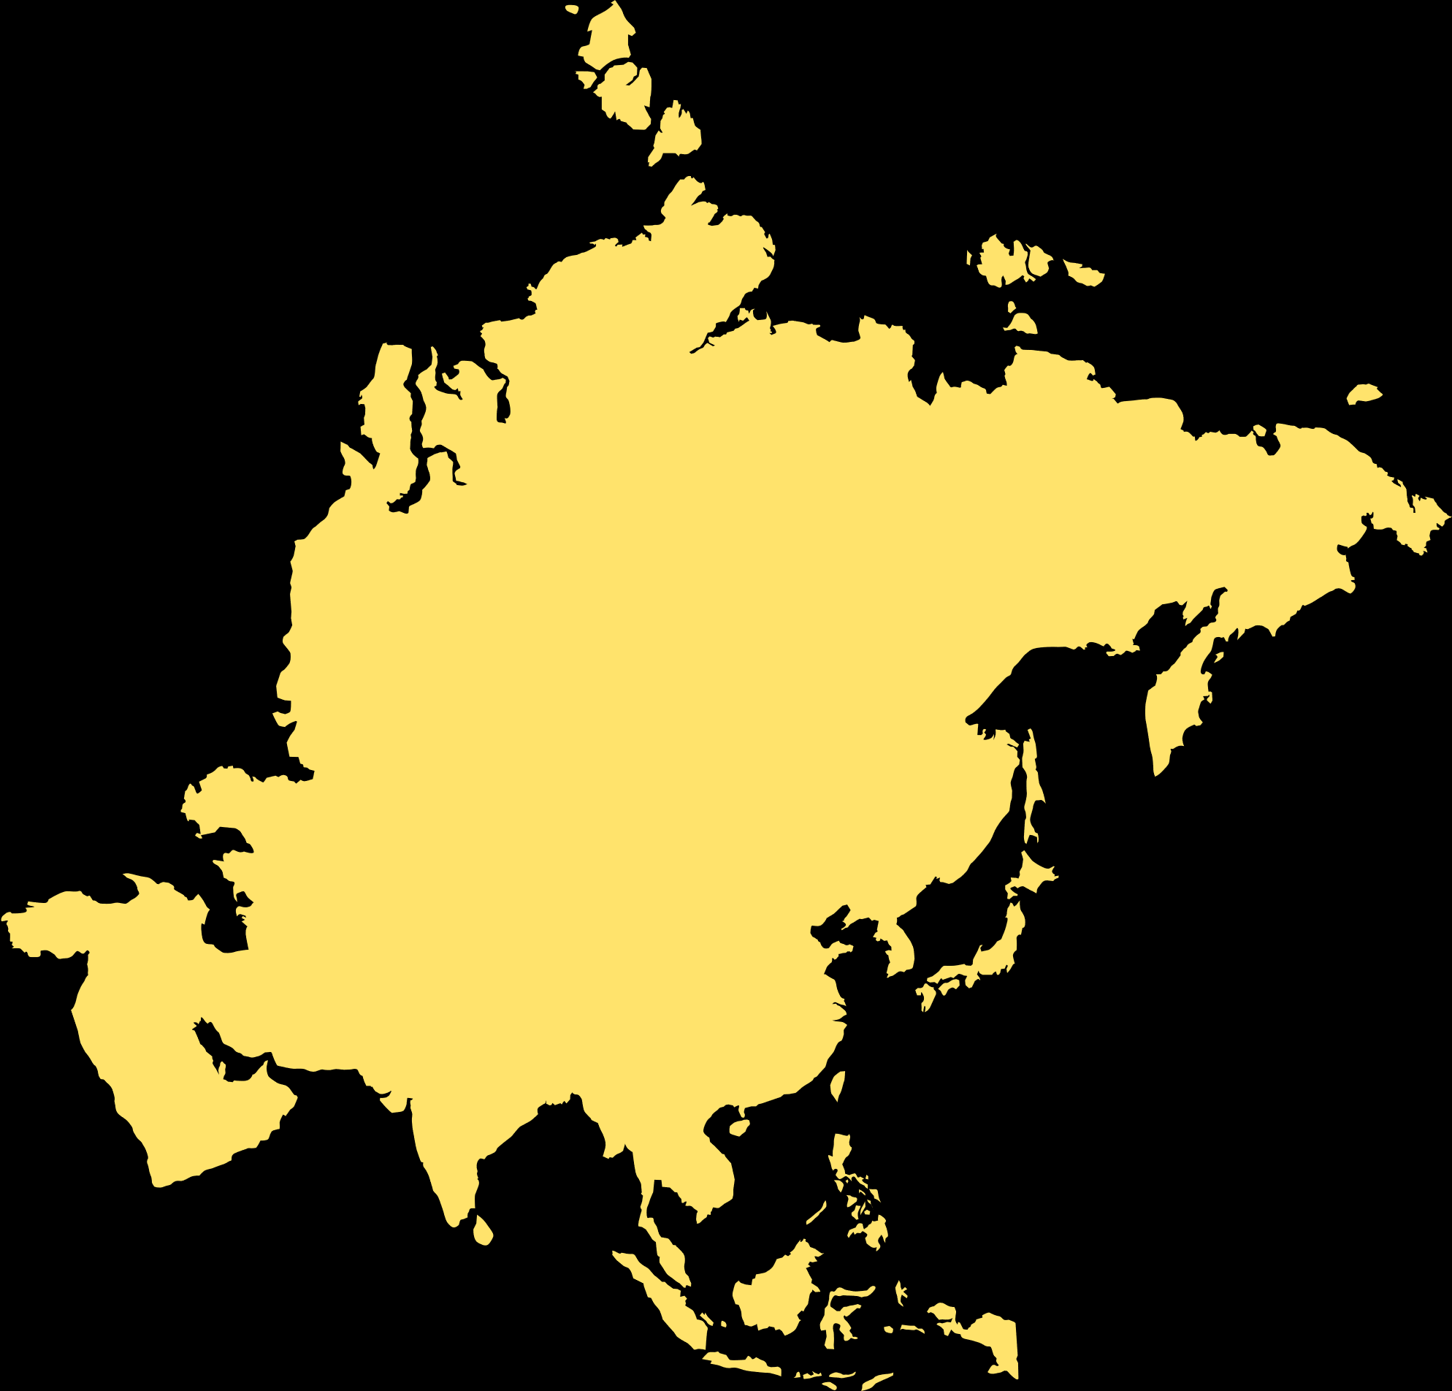
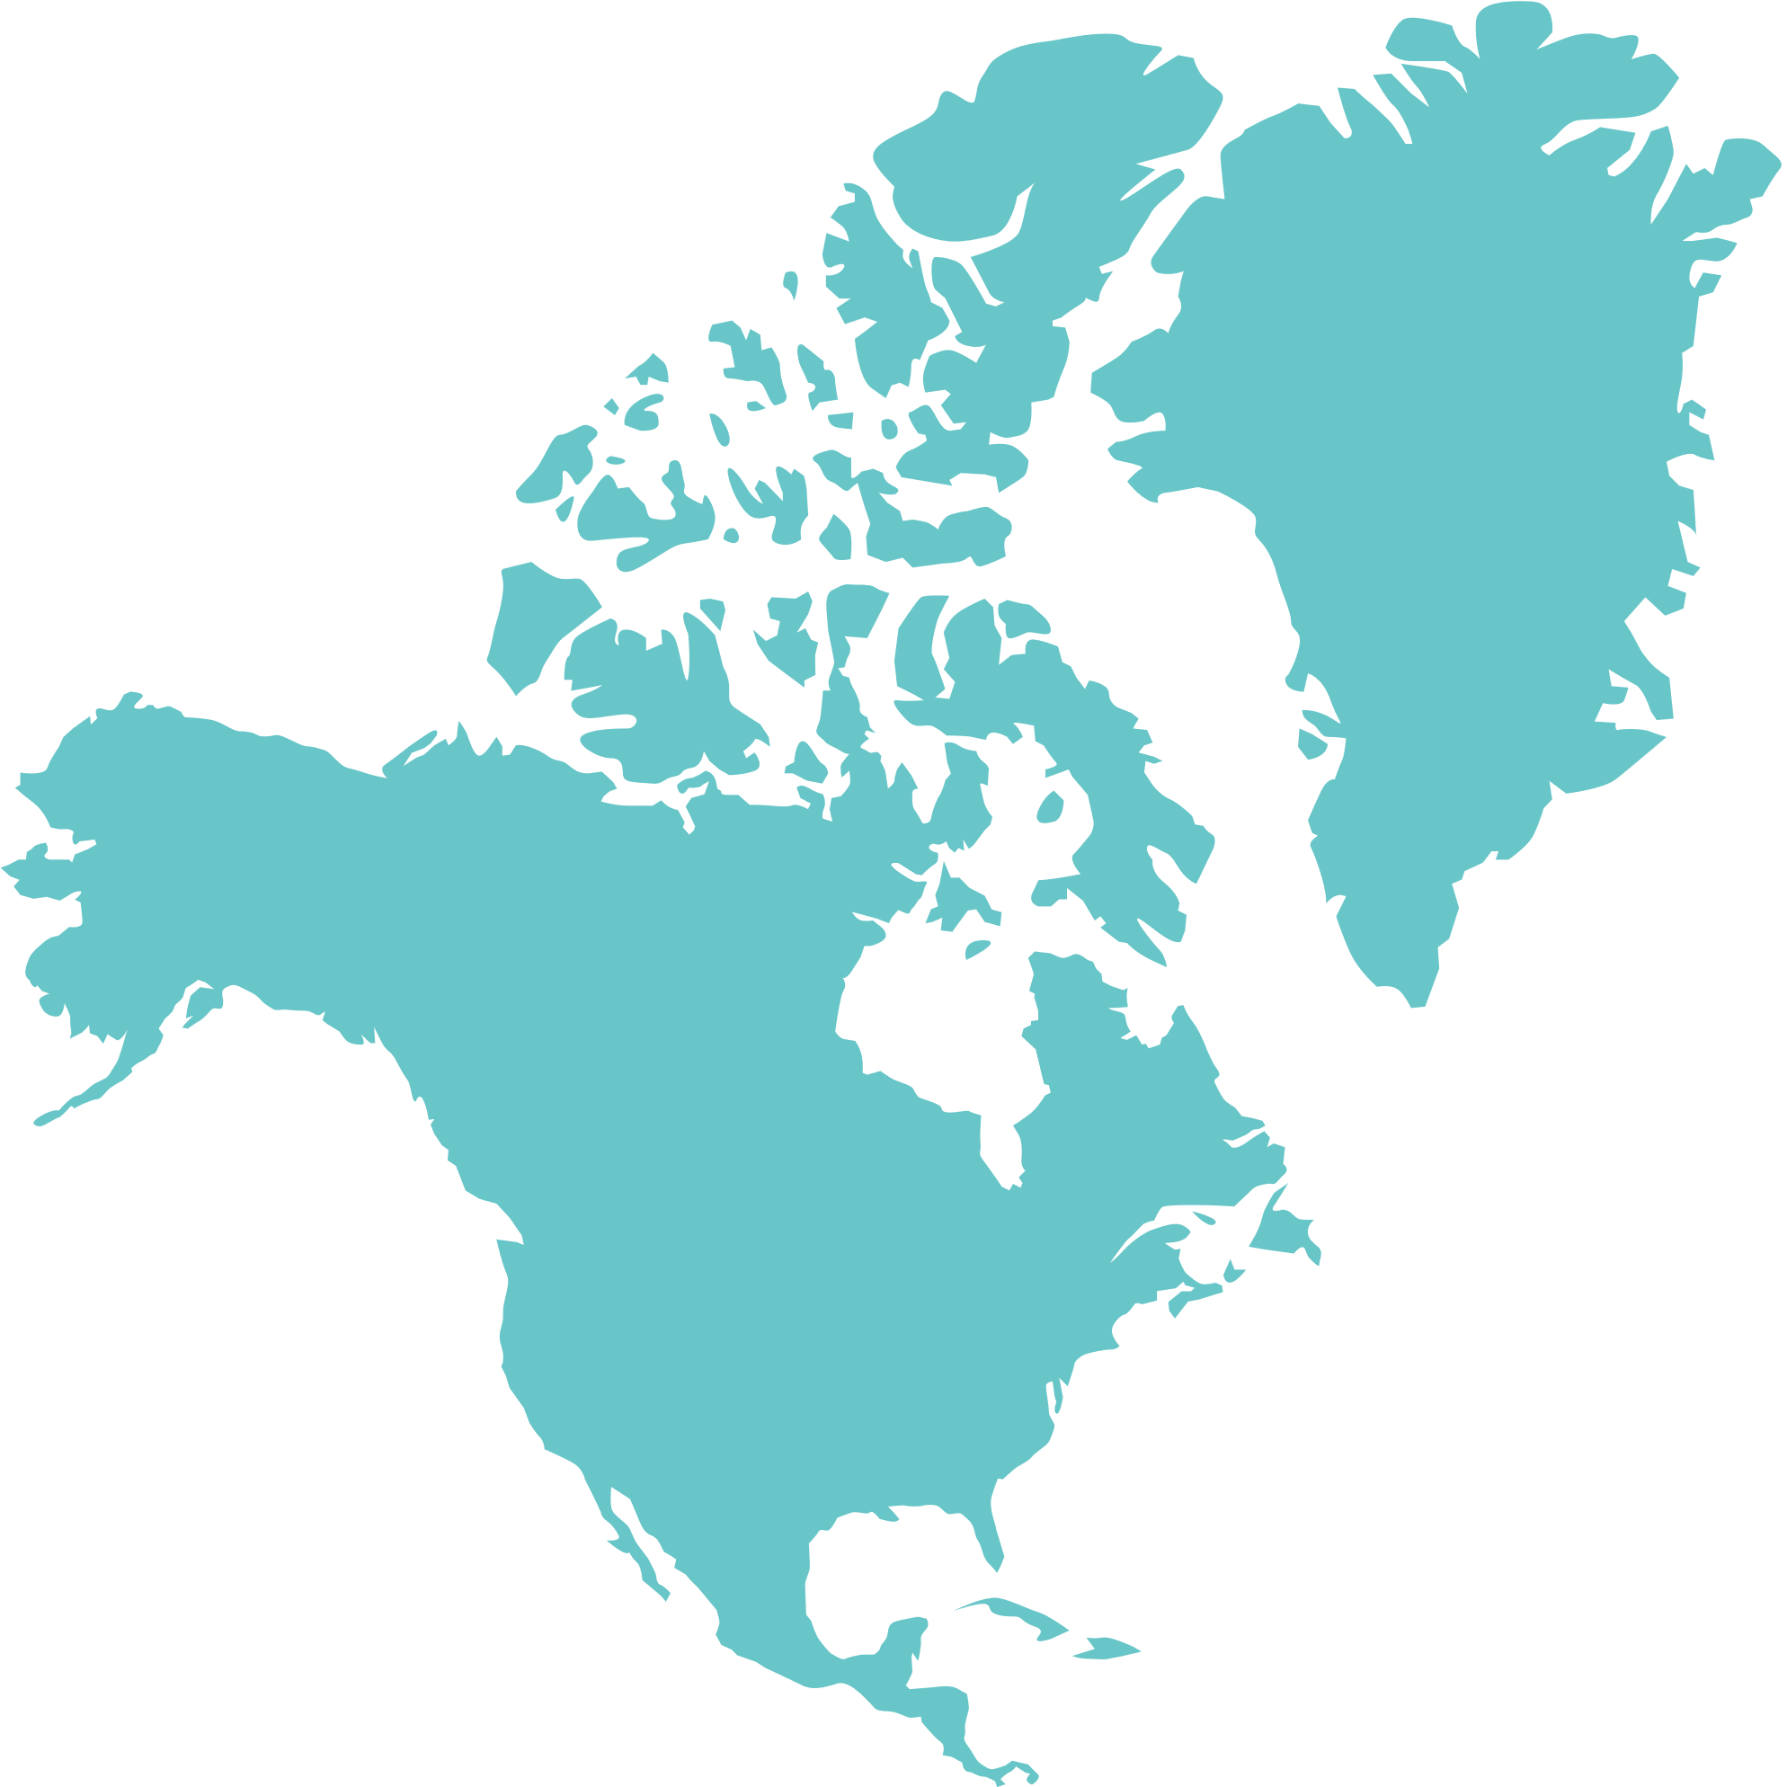
R Shiny Ecosystem
Shiny + shinydashboard - Interactive UI framework
Leaflet - Dynamic mapping with geolocation markers
Plotly/ggplot2 - Interactive charts (AQI trends, weather forecasts)
Data Processing
dplyr - Data wrangling & transformation
lubridate - Time-series analysis
httr/jsonlite - API integration & JSON parsing

Slide 4
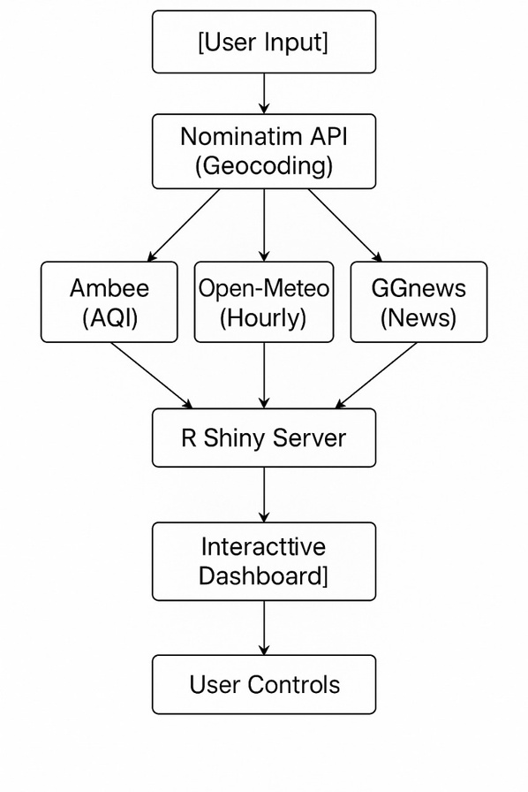
Real-Time Data APIs
Ambee API - Live AQI/pollutant data (PM2.5, CO, NO₂)
OpenWeatherMap - 5-day weather forecasts
Open-Meteo - Hyperlocal hourly weather metrics
GNews API - Location-based environmental news
Nominatim (OSM) - Geocoding & address lookup

Slide 5
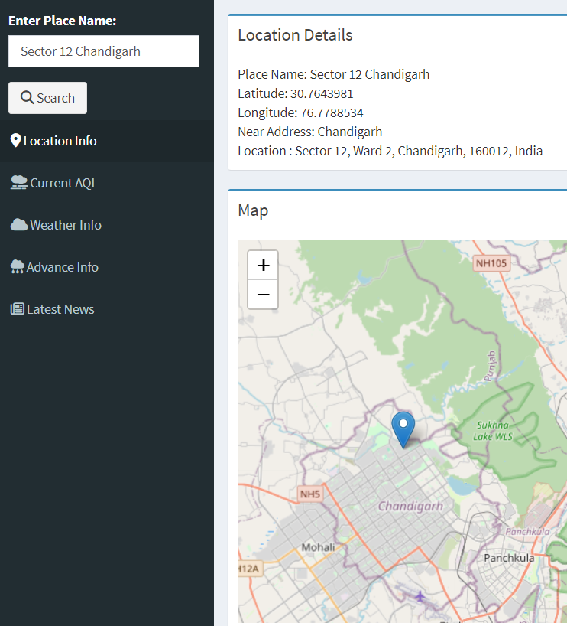
Fetching Real-Time Data
🌍 User Input
Location search (e.g., "Delhi")
🔍 Geocoding
Convert place names to coordinates (Nominatim)
📡 API Integration
Air quality (Ambee)
Weather forecasts (OpenWeatherMap/Open-Meteo)
Local news (GNews)
🗺️Live Maps
Leaflet maps with location markers

Slide 6
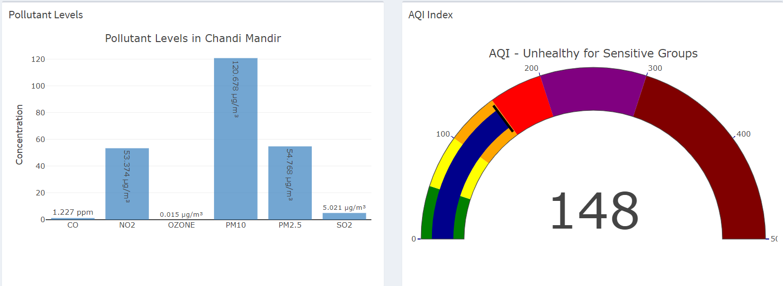
AQI Categories:
0-50 (Good) - Minimal impact
51-100 (Moderate) - Acceptable
101-150 (Unhealthy for Sensitive Groups) - At-risk individuals affected
151-200 (Unhealthy) - Everyone may experience effects
201-300 (Very Unhealthy) - Health warnings
300+ (Hazardous) - Emergency conditions
Key Pollutants Monitored
PM2.5/PM10: Fine particles from vehicles, industry
Ozone (O₃): Summer smog component
NO₂: Traffic emissions
SO₂: Industrial combustion
CO: Incomplete fuel burning

Slide 7
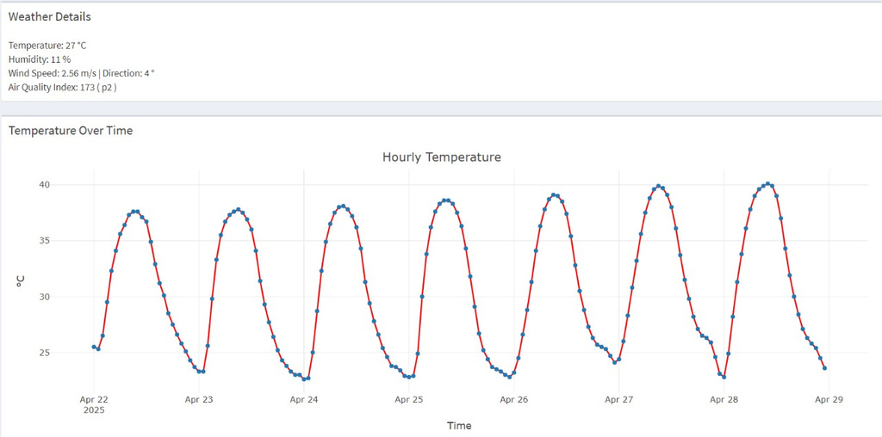
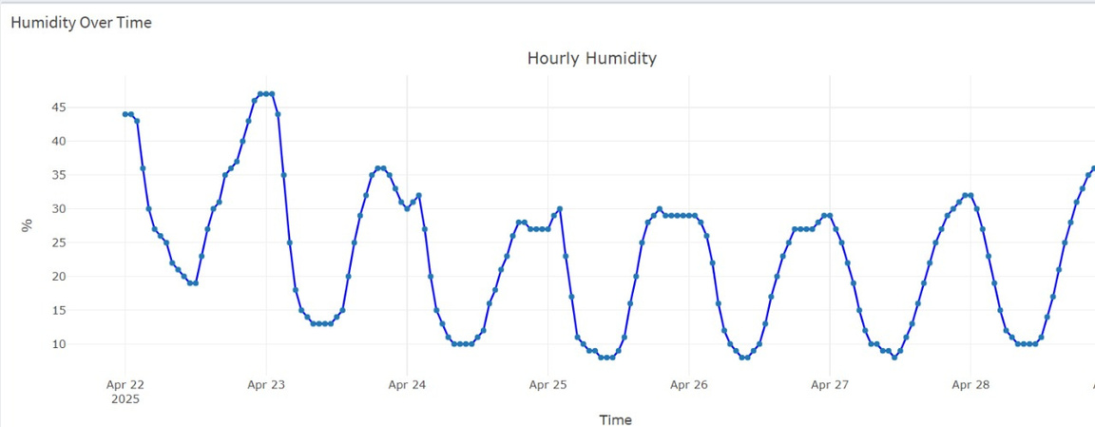
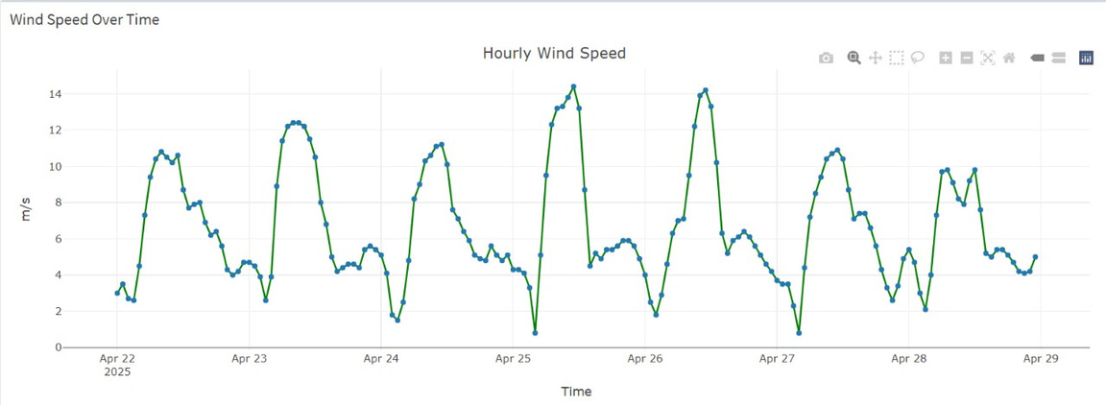
1. Temperature Trends
Daily fluctuations: ±3°C normal range
Seasonal variations:
Summer avg: 28-35°C
Winter avg: 12-18°C
Heatwave threshold: >40°C (3+ consecutive days)
2. Wind Speed Metrics
Beaufort Scale Reference:
0-1 m/s: Calm
1-5 m/s: Light breeze
5-10 m/s: Moderate wind
10+ m/s: Strong winds
3. Humidity Patterns
Optimal range: 40-60% RH
Health thresholds:
>70% = Mold risk
<30% = Dry air alert
Dew point correlation:
(T-Td) <5°C = Fog potential

Slide 8
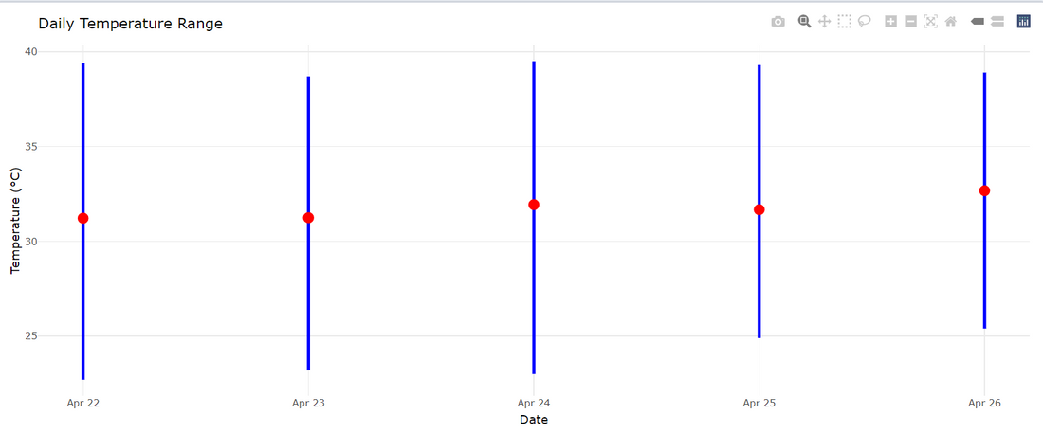
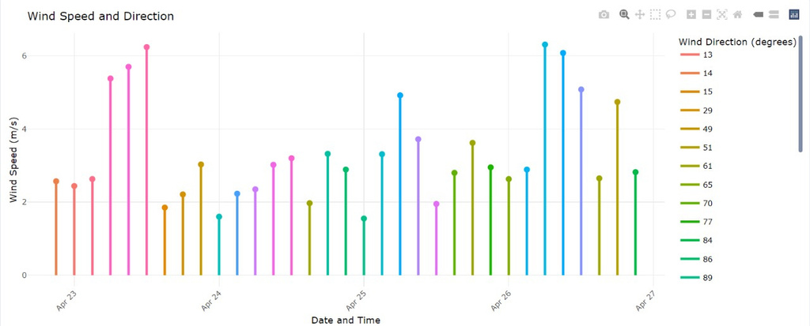
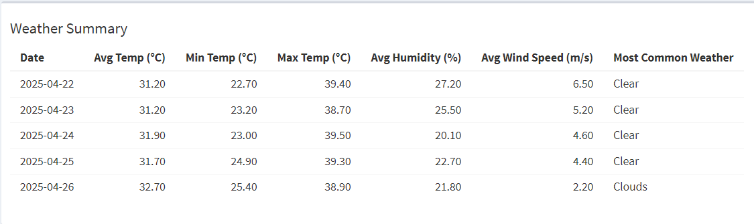
🌡 Temperature Trends
Today's Range: 25.5°C (Low) → 32.4°C (High)
Warming Trend: +1.0°C vs yesterday
Heat Stress: Moderate (ΔT 6.9°C)
🌬 Wind Analysis
Current Speed: 4.5 m/s (Moderate breeze)
Peak Gusts: 6.5 m/s (Morning hours)
Safety Alert: Calm evenings (2.3 m/s)
☀ Weather Conditions
Sky: Mostly clear (4-day streak)
Humidity: Low at 21.9% (Dry air warning)
UV Index: Moderate (SPF 30+ recommended)

Slide 9
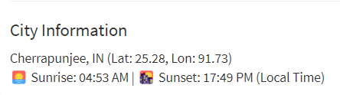
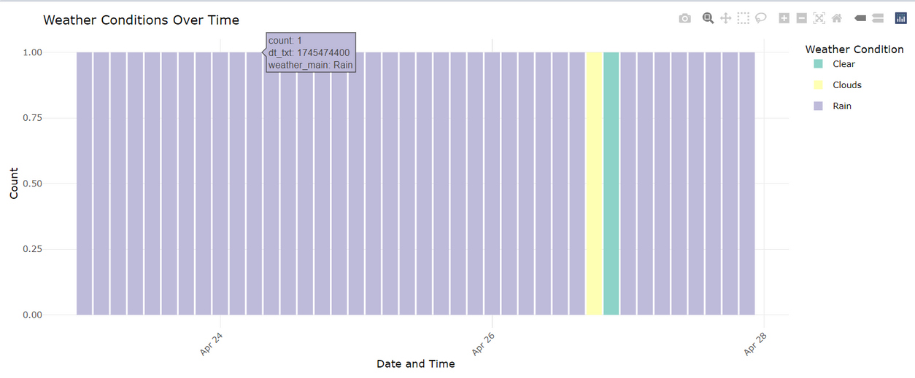
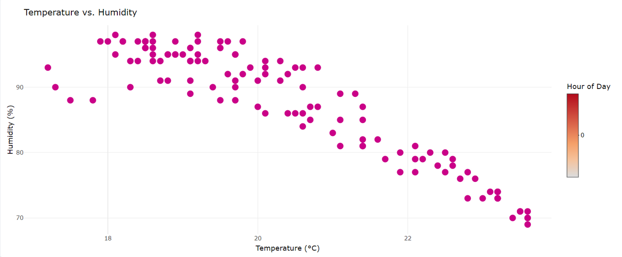
📈 Weather Conditions Over Time:
A bar chart displays hourly weather status across multiple days.
Color Legend:
🟪 Rain, 🟨 Clouds, 🟩 Clear
Insight: Cherrapunji experiences frequent rainfall, with short durations of clear or cloudy weather.
🌡️ Temperature vs. Humidity:
A scatter plot compares hourly temperature (°C) with humidity (%), with data points colored by the hour of the day.
Trend Observed: As temperature rises, humidity decreases—a typical pattern in humid tropical climates.

Slide 10
THANK YOU

